Slide 1
Announcement August 26, 2018

Slide 2
Registration is underway for this
year’s PREP classes
Register in the PREP office on
Sunday, September 2 after all Masses
Download the registration form
at olqa.cc under ‘Faith Formation’

Slide 3
COME JOIN OUR
YOUTH GROUP!
We are meeting this Sunday evening from
7:00 to 9:00 in Celebration Hall.
Bring a friend!
They don’t have to be Catholic to be involved.
Please see the bulletin for details

Slide 4
Interested in becoming Catholic?
Know anyone who is interested?
RCIA Classes will start September 10th!
See the bulletin for more information

Slide 5
Ladies of the parish!
You are invited to the Council of Catholic Women’s (CCW) Annual Potluck Dinner
Come discover what we are about
Tuesday, September 4
6:00
Celebration Hall
See the bulletin or the gift shop for details

Slide 6
Our Lady Queen of the Apostles
Council 12376
Scotch/Bourbon and Cigars for Vocation
A tasting FUNDRAISER FOR VOCATIONS
WELLINGTON TRACE TAVERN
SATURDAY, SEPTEMBER 8,
7:00-9:00
See the bulletin for details

Slide 7
KNIGHTS OF COLUMBUS
SPAGHETTI DINNER
Wednesday, September 12
5:00 to 7:00
Celebration Hall
Cost $9.00 per adult, $5.00 per child $24.00 per family
All you can eat pasta
50/50 Raffle

Slide 8
Christmas Festival Meeting
If you are a Booth Captain
or want more information,
please join us
Wednesday, August 29
7:00
Celebration Hall

Slide 9
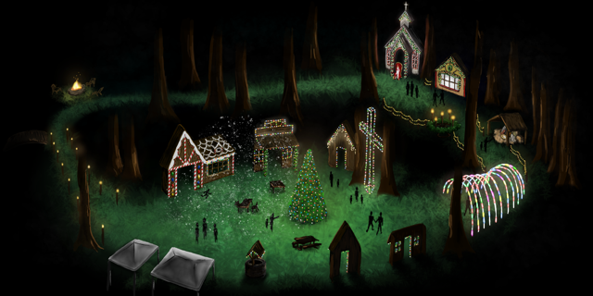
We need your help with our Christmas Village!
Do you love Christmastime? Are you crafty?
Do you have carpentry skills?
Please join us on Wednesday at 7:00 PM in Celebration Hall and see how you can be part of the excitement!

Slide 10
Bible Study
The Gospel of St. John
Thursday evenings, 7:00—8:30

Slide 11
Support the parish while you are
away this summer.
Call the parish office for
more information.

Slide 12
Have a great week, and remember to lock your car doors!

